Slide 1
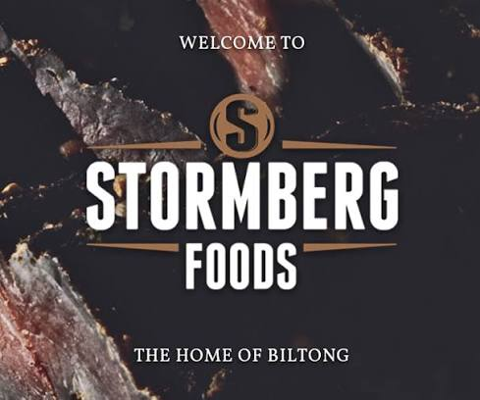

EXECUTIVE STATUS · OCTOBER 14, 2026
OCTOBER PROGRESS
FOLLOW-UP ON THE OCTOBER 1–9 UPDATE · DATA THROUGH OCTOBER 13
BROOKLYN BILTONG
AYOBA FOODS
BEG & BARKER
Notes:
Open by thanking him for his time. This is the follow-up to the October 1–9 email: what we did, what we see in the data, and what we'll do this week for each brand. We're not asking for decisions; we're sharing the plan and will report results in a week.

Slide 2
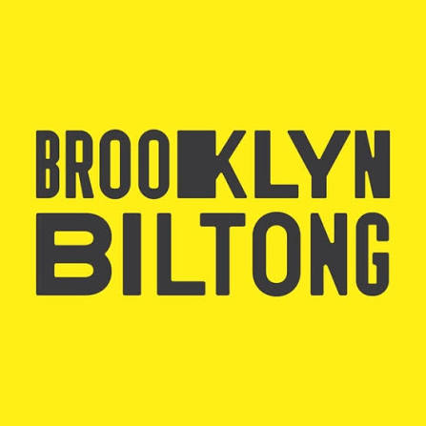
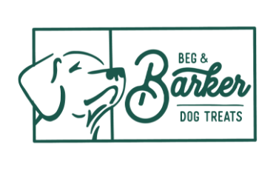

EXECUTIVE SUMMARY
One focus: efficiency and profitable growth
+90%
$11K → $6.3K
58%
Brooklyn daily sales
Of Ayoba's customers
Oct 10–12 vs. Oct 1–9
are repeat customers
Brooklyn investment
May vs. Oct, steady margin
THE MESSAGE BY BRAND
We cut investment by about 40% and the margin held. Now the focus is sales growth, starting with tomorrow's Fast Sale.
It's efficient, but search is very hard to compete in. We're focusing paid media on new customers with promos and on Amazon.
Traffic is good but the website converts poorly. We propose an Amazon test and replicating Brooklyn's strategy.
STORMBERG FOODS · EXECUTIVE STATUS
02
Notes:
First, how we work: we don't stop at what an AI tool says; we go into the dashboard and each platform to understand what drives every number. From that, there's one message per brand. Brooklyn: we held the margin while cutting investment by about 40%, and now the challenge is growing sales. Beg & Barker: it's efficient, but competing in search is very hard, so we're shifting focus to new customers with promos and to Amazon. Ayoba: traffic is good, but the website converts poorly, so we propose testing toward Amazon.

Slide 3
BROOKLYN BILTONG · LAST WEEK
Positive signals from the last week
STORE DAILY SALES (USD), OCTOBER
Oct 10–12 · Meta on
$4.5–5K
in steady monthly profit since May, on about 40% less media investment
$2.0K
More profitable flows
$1.04 per recipient (vs. $0.21 in September) and $80 a day (+40%)
$1.6K
$1.6K
Smile is growing
Customers earning points: 74 → 82 a week (+11%) since paid media began
Subscriptions up
Subscribe & Save flow live since Oct 7
1
2
3
4
5
6
7
8
9
10
11
12
13
Google: Brand and PMax
Brand ROAS 4.69× and PMax 2.12×, lifted indirectly by Meta
SOURCE: KLAVIYO, BROOKLYN FINANCIAL ANALYSIS, PLATFORM REPORTS
03
Notes:
Brooklyn is the brand responding best. From October 10 to 12 it sold $1,745 a day, nearly double the first nine days of the month, right as we turned Meta on. The adjusted flows now earn five times more per recipient than in September, Smile is growing since we started promoting it, and subscriptions are up. On Google, Brand is at a 4.69x ROAS and PMax at 2.12x, with Meta lifting them indirectly.

Slide 4
BROOKLYN BILTONG · EFFICIENCY
Less investment, same margin
WHAT WE SEE IN THE DATA
MONTHLY MEDIA INVESTMENT (USD)
Subscriptions and value per purchase are rising
Conversion moved from 2.54% to 2.16% due to a traffic-objective campaign; sessions outside social fell 11%
$11.0K
$7.1K
Meta retargeting does its job: it indirectly lifts the other campaigns
$6.3K
Email: more sends, more focused, with themed flows
NEXT STEP: GROW SALES
May
September
October
The Fast Sale starts tomorrow, October 15.
SOURCE: BROOKLYN DASHBOARD AND PLATFORM ANALYTICS
04
Notes:
The key point: we cut investment from $11K in May to $7.1K in September and a $6.3K trend in October, and the margin held at around 20%. Subscriptions and value per purchase went up. Conversion fell from 2.54% to 2.16% because of a campaign optimized for traffic, and sessions outside social dropped 11%. New customers went from 84 to 75, so acquisition is the next push. Meta retargeting does what it should, with an indirect lift on the other campaigns. In email we'll send more, more focused messages. The next step is growing sales, and it starts tomorrow with the Fast Sale.

Slide 5
BROOKLYN BILTONG · EMAIL & SMS
Email and SMS are driving repeat sales
SALES BY PROGRAM (USD)
$2,074
First-purchase flow
$647
in email and SMS-attributed sales, Oct 1–14
Game Day (email + SMS)
$585
Other flows and sends
$266
SMS Welcome
$265
31
Win-back
$166
$10-off reminder
$145
orders; 17 came in automatically through flows
Game Day had a 60% open rate. Subscribe & Save and Second Order flows live since Oct 7.
SOURCE: KLAVIYO, PLATFORM-ATTRIBUTED ORDERS
05
Notes:
Email and SMS are already driving repeat sales: $2,074 and 31 orders from October 1 to 14, 17 of them from automated flows. Game Day had a 60% open rate.

Slide 6
BROOKLYN BILTONG · WHAT'S NEXT IN EMAIL
The new email program
1ST ORDER
›
First Purchase + Bounce-Back
›
2ND ORDER
›
Subscribe & Save + Replenishment
›
3RD ORDER
›
VIP Welcome
›
Anniversary
If they stop buying: Win-Back A (one order) or Win-Back B (two or more orders)
NEW FLOWS
Browse Abandonment: for people who view a product but don't add it to cart
SIMULTANEOUS HYPER-SEGMENTED CAMPAIGNS
Replenishment: "running low?" timed to the pack (3 bags at 21 days, 5 at 30, 7 at 40)
Several campaigns go out the same day, each to one micro-segment: subscribers, VIPs, one-time buyers, clickers who never bought, cold base. Nobody gets two the same day.
VIP Welcome: at the 3rd order, no discount: status, early access and a new flavor
Anniversary: one year after the first order
Win-Back B: reactivate 2,493 lapsed repeat buyers
This week: micro-segments and Browse Abandonment, after the Fast Sale
Week of Oct 19: first wave, Replenishment and VIP Welcome
From Oct 25: Win-Back B
STORMBERG FOODS · EXECUTIVE STATUS
06
Notes:
Here is what's coming in email for Brooklyn. Each order moves the customer to the next flow, from the first order to the VIP Welcome and the anniversary, and if they stop buying they enter the right Win-Back. We're adding five new flows: Browse Abandonment, Replenishment timed to the pack, VIP Welcome at the third order with no discount, Anniversary, and Win-Back B for 2,493 lapsed repeat buyers. We're also moving to simultaneous hyper-segmented campaigns, with nobody getting two. We start this week, right after the Fast Sale.

Slide 7
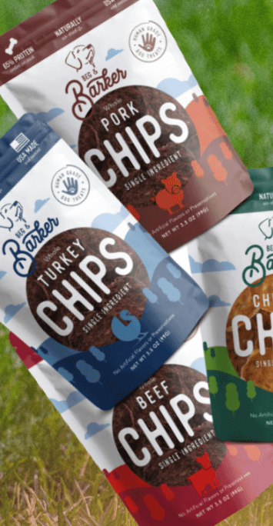
BEG & BARKER · YEAR TO DATE
A solid, recurring base
$89.9K
44%
$2.21
in sales, from 1,181 orders at a $76 average ticket
of sales are subscription renewals: $40K recurring this year
per recipient from flows, 13× more than campaigns
Steady sales
Brand search
~$9.3K a month in Q1 and ~$9.7K from April to September
Google's most profitable line, with a return close to 3×
Dynamic retargeting
Refreshed welcome
3.1× return on Meta ahead of the Oct 10 restructure
BARK15 Welcome live since Oct 6; SMS Welcome on the way
SOURCE: STORE DASHBOARD (JAN 1 – OCT 13), KLAVIYO, GOOGLE ADS, META · 07
Notes:
Beg & Barker has a solid base: $89.9K in sales this year, 44% from subscription renewals, steady month-to-month sales, and flows that earn 13 times more than campaigns. Brand search is Google's most profitable line.

Slide 8
BEG & BARKER · DIRECTION
New customers and Amazon
→
WHERE WE ARE
WHERE WE'RE HEADING
Sales below last month, on 35% less investment
New-customer campaigns with promos, not brand
Efficiency is good, but on a low investment
Shift paid media toward Amazon and measure its contribution
Search is very hard to compete in
Full-page branding that goes straight to Amazon, plus catalog and retargeting
New customers are hard to win: Amazon and our own brand compete for the same searches
Keep the Meta budget and keep optimizing it
STORMBERG FOODS · EXECUTIVE STATUS
08
Notes:
To be transparent: sales are below last month, on 35% less investment. Efficiency is good, but investment is low, and new customers are hard to win because Amazon and our own brand compete for the same searches. So the focus is new-customer growth through promos, not brand, and shifting paid media toward Amazon while measuring its contribution. We're keeping the Meta budget for now, optimizing the active campaigns and monitoring their indirect return.

Slide 9
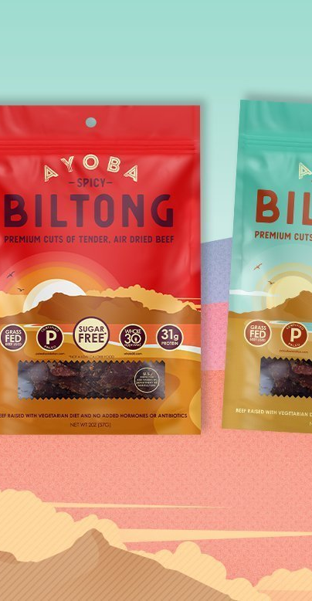
AYOBA FOODS · YEAR TO DATE
High ticket and a profitable operation
$107.8K
60%
4.2×
in gross sales, from 1,188 orders
gross margin after product cost: $64.7K contribution
in sales per dollar invested in paid media this year
Highest ticket
New customers
$91 average per order, the highest in the portfolio
523 this year, at about $49 each
Healthy sales
Meta in October
Discounts of just 5.7% and returns of 3.5% of sales
New-customer campaign at $26 per purchase in its first week
SOURCE: AYOBA SHOPIFY DASHBOARD (JAN 1 – OCT 13), META ADS MANAGER (OCT 6–13) · 09
Notes:
Ayoba has the highest ticket in the portfolio, $91 per order, a 60% gross margin, and $4.20 in sales for every dollar invested this year.

Slide 10
AYOBA FOODS · DIRECTION
Good traffic, the focus is Amazon
→
WHERE WE ARE
WHERE WE'RE HEADING
Very low sales on the website
A/B test: brand campaign toward Amazon to measure the result
Traffic is good, but site layout and long product copy hold conversion back; under review
Goal: add 10% to Amazon sales (if it sells $10K, +$1K)
October: $3.1K in sales at a 3.6× blended return
Low, performance-optimized web spend
58% of customers are repeat buyers: the challenge is new-customer volume
Replicate Brooklyn's strategy: subscription and repeat purchase
STORMBERG FOODS · EXECUTIVE STATUS
10
Notes:
Ayoba sells very little on the website. Incoming traffic is good, but site layout and long product copy on pages like Beef Sticks and Gift Boxes hold conversion back; we are reviewing those changes. October is at $3.1K with a 3.6x blended return. 58% of customers are repeat buyers; the challenge is new-customer volume. The proposal is an A/B test: a brand campaign toward Amazon, with the goal of adding 10% to Amazon sales. We keep web spend low and optimized, and replicate Brooklyn's strategy.

Slide 11
PLAN
What we'll do this week
BROOKLYN BILTONG
BEG & BARKER
AYOBA FOODS
Fast Sale (Oct 15): 20% for past buyers, 15% for an open audience; reminder Oct 16, last call Oct 18
New-customer campaigns with promos
A/B test of a brand campaign toward Amazon (+10%)
Paid media toward Amazon: full page, catalog and retargeting
New flows and hyper-segmented campaigns starting this week
Replicate Brooklyn's subscription strategy
Keep Meta optimized and monitor its indirect return
Campaigns: Taco Night, Oktoberfest and Cabin Weekend
Grow sales by scaling retargeting and Smile
Oct 21
Next follow-up: results of Brooklyn's Fast Sale and the first read of the Amazon tests for Beg & Barker and Ayoba.
STORMBERG FOODS · EXECUTIVE STATUS
11
Notes:
Close with this week's plan by brand and the follow-up commitment: on October 21 we'll share the results of Brooklyn's Fast Sale and the first read of the Amazon tests. No decisions needed today.

Slide 12
APPENDIX
October 9 commitments: status by brand
BRAND
COMMITMENT
STATUS
WHERE IT STANDS
Brooklyn
New-customer campaign on Meta
Done
Live since Oct 5. Budget trimmed Oct 13 ($1,000 → $800) on high cost per purchase
Brooklyn
Offer vs. No-Offer A/B test
Done
Closed Oct 6; 10%-off new-customer ad sets launched Oct 7
Brooklyn
Smile / W10 program
Done
List-based and lookalike audiences live on Meta; $210 invested
Brooklyn
Game Day email and SMS (Oct 11)
Done
6,770 emails and 308 SMS: 7 orders, $585
Brooklyn
Fast Sale: 20% buyers / 15% open
On track
6 sends built: launch Oct 15, reminder Oct 16, last call Oct 18
Brooklyn
Recurring → Subscription flow
In setup
Built and in testing; not live yet
Ayoba
New customers + Smile10 on Meta
Done
3 purchases at $26 each: lowest cost per purchase in the portfolio
Beg & Barker
New customers + new BARK15 Welcome
Done
Campaign live since Oct 7 ($200 → $300); Welcome live since Oct 6
All 3 brands
Dynamic retargeting (added)
Done
Oct 10: catalog ads to 90-day viewers and cart adders, excluding buyers
STORMBERG FOODS · EXECUTIVE STATUS
12
Notes:
Backup appendix: status of each commitment from the October 9 email. Use only if asked.

Slide 13
APPENDIX
Meta: more volume, efficiency still being built
WHAT'S WORKING
META-ATTRIBUTED PURCHASES
Oct 1–5
Oct 6–13
Ayoba new customers: $26 per purchase, 1.6× return
Brooklyn dynamic retargeting: $26 per purchase, 2.9× return
Beg & Barker dynamic retargeting: 3.1× return
WHAT WE'RE FIXING
9
Brooklyn new customers: $170 per purchase → budget trimmed on Oct 13
New retargeting (since Oct 10) is still learning; budget raised for Ayoba and Beg & Barker
4
2
1
1
0
Brooklyn
Ayoba
Beg & Barker
SOURCE: META ADS MANAGER; EXCLUDES GOOGLE ADS AND TOTAL STORE SALES
13
Notes:
Backup appendix: Meta detail by brand. Use only if asked.

